Slide 1
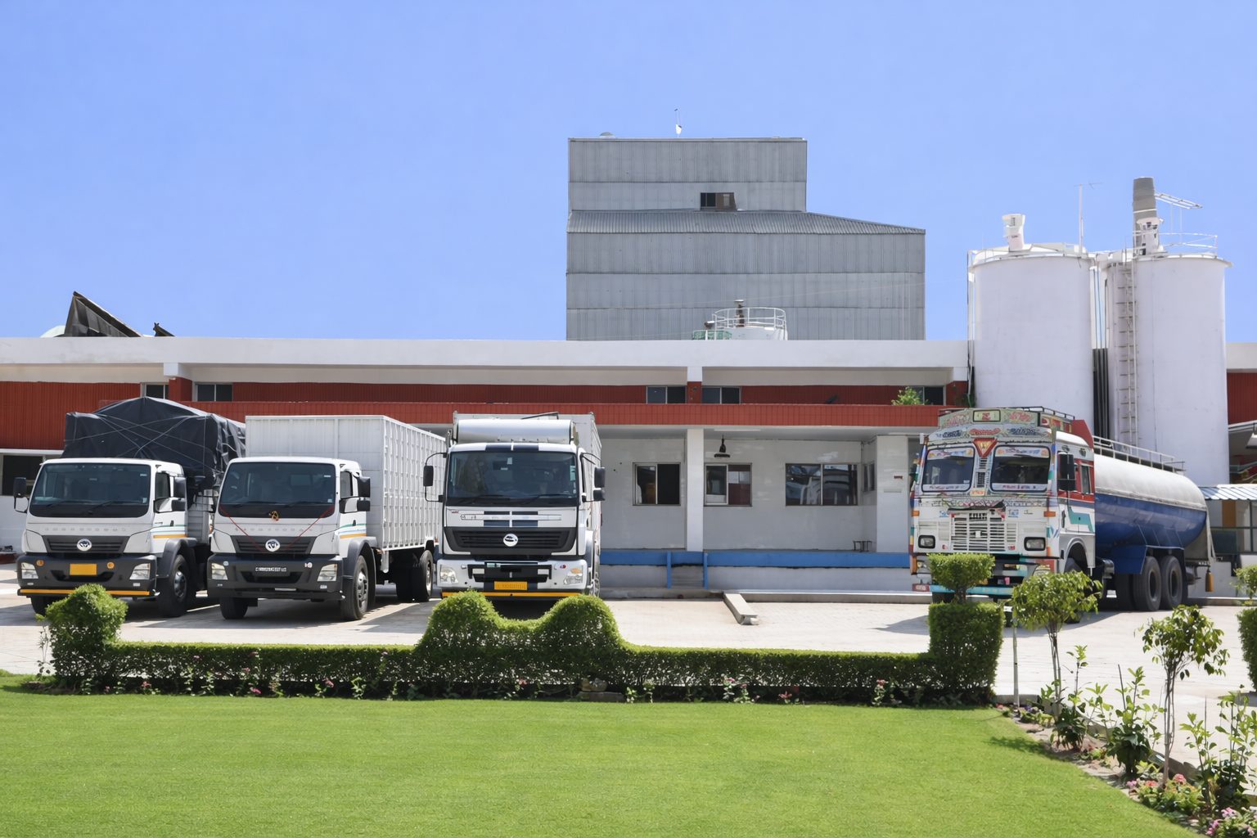
Narayan Agro Foods Ltd Kot Kapura

Slide 2
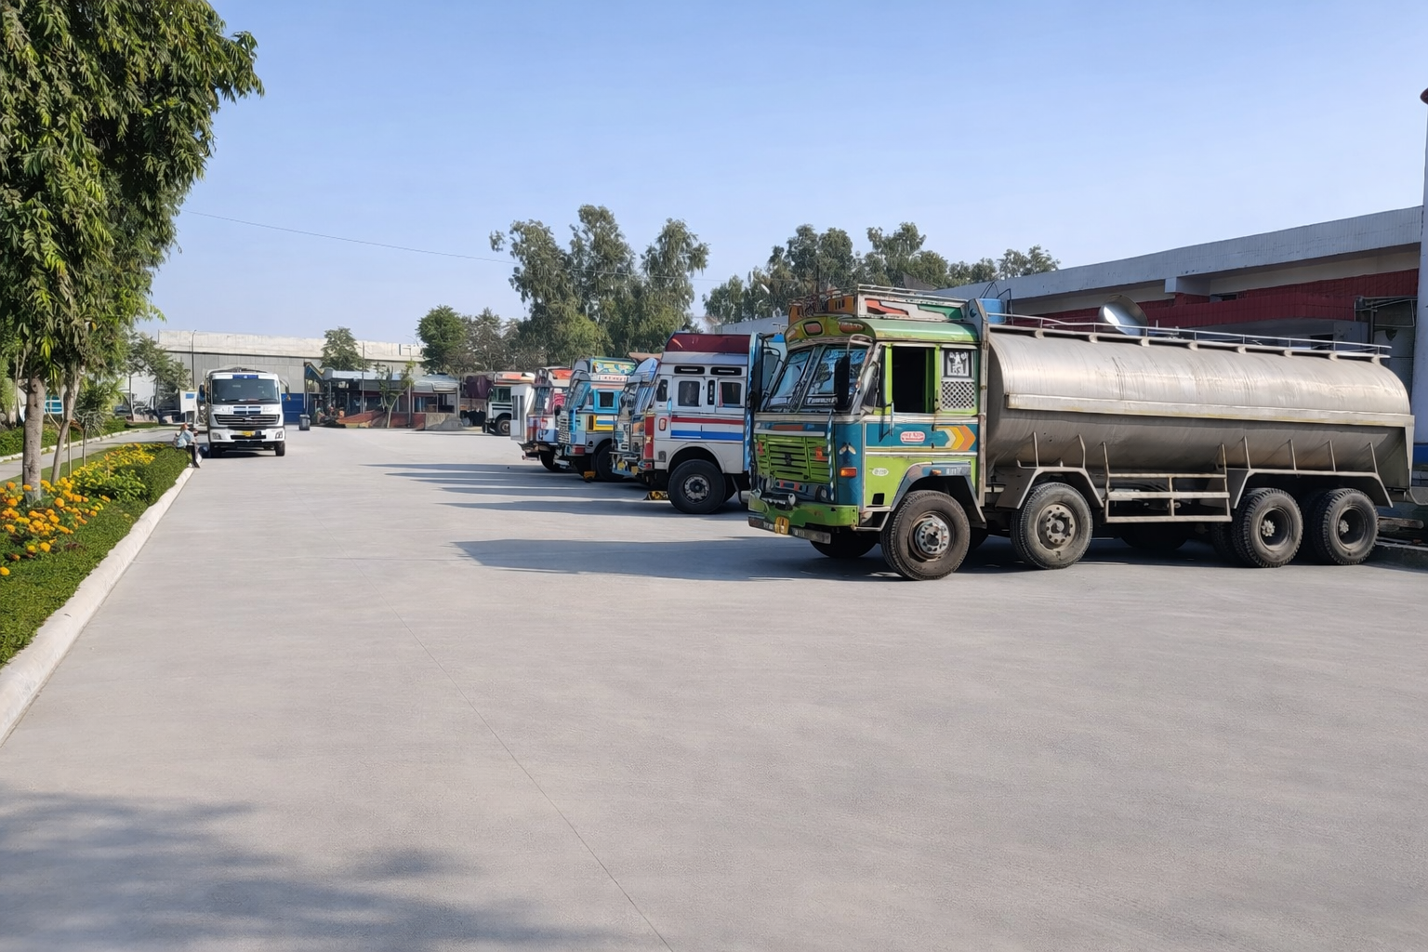
Main Entrance for milk tankers

Slide 3
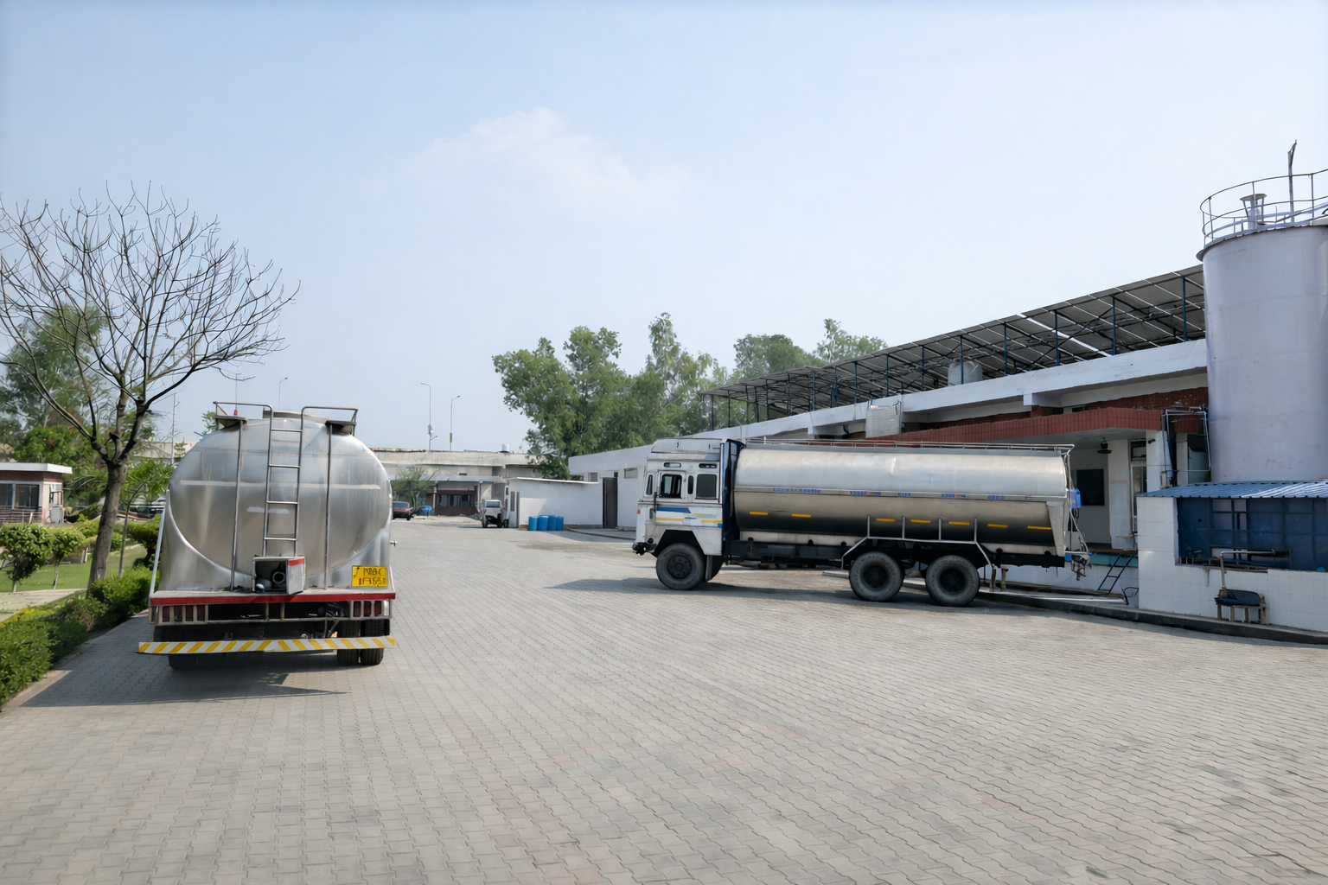
Milk unloading dock area

Slide 4
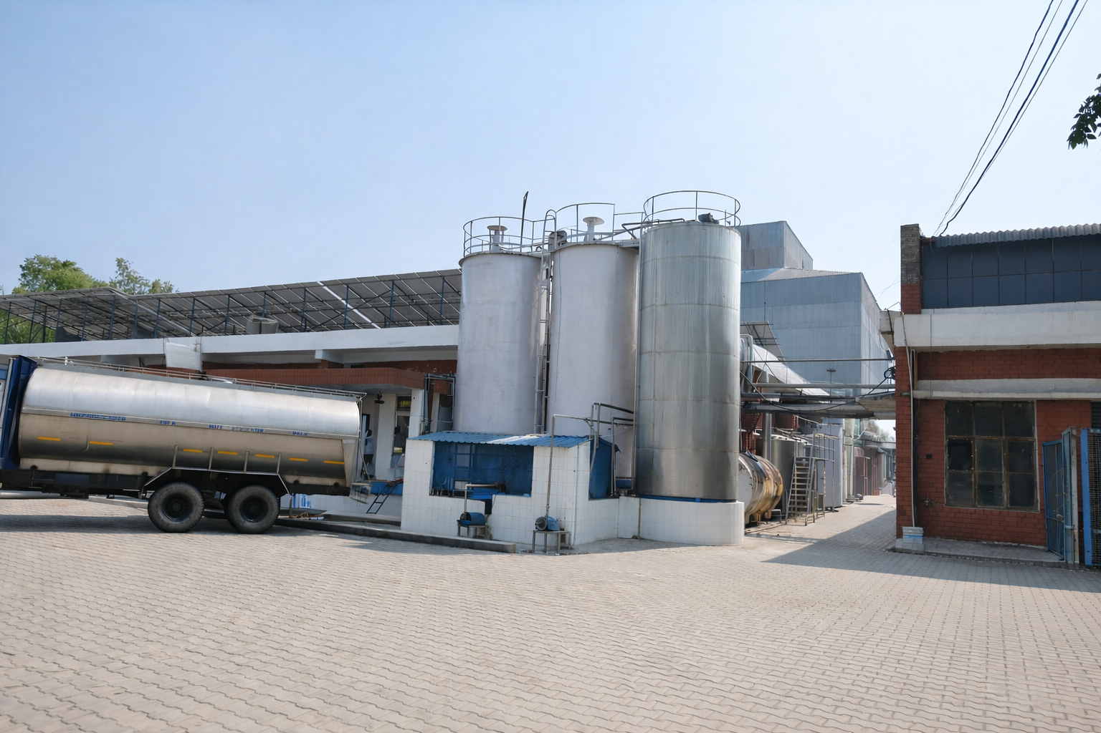
Raw milk storage tanks

Slide 5
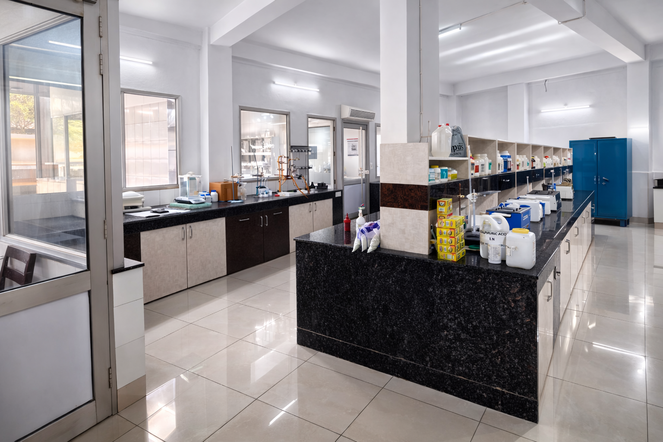
Milk Dock Lab

Slide 6
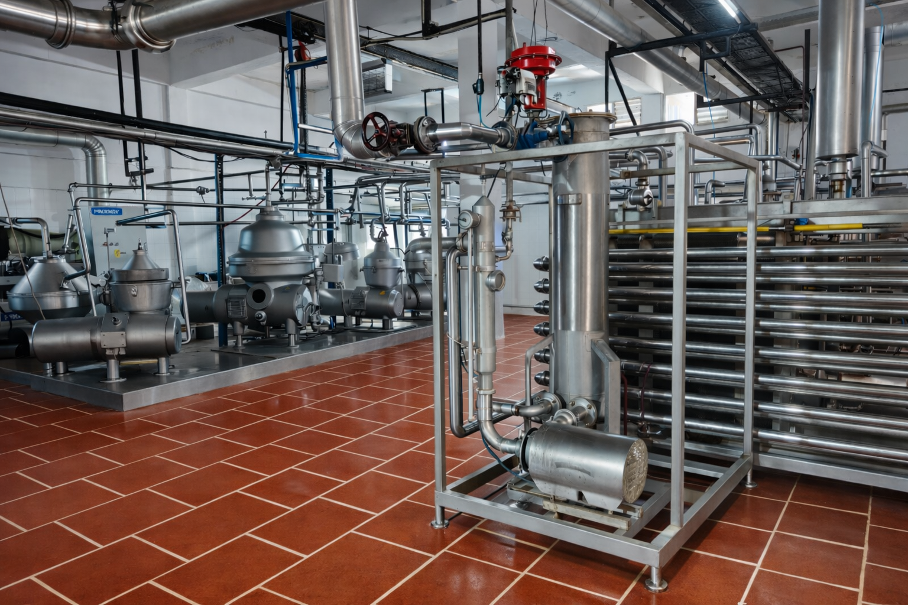
Milk Processing area

Slide 7
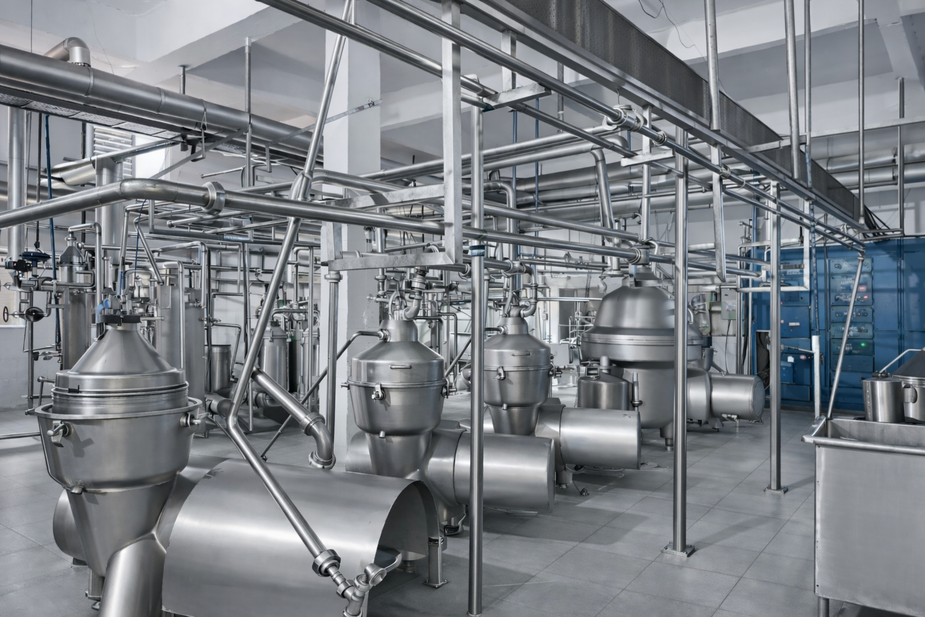
Milk Pasteurizers and Separators

Slide 8
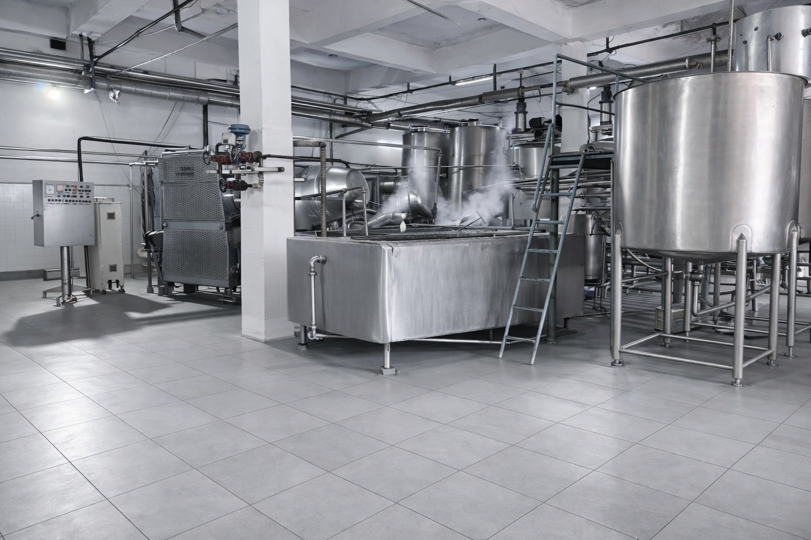
Butter and Ghee making Area

Slide 9
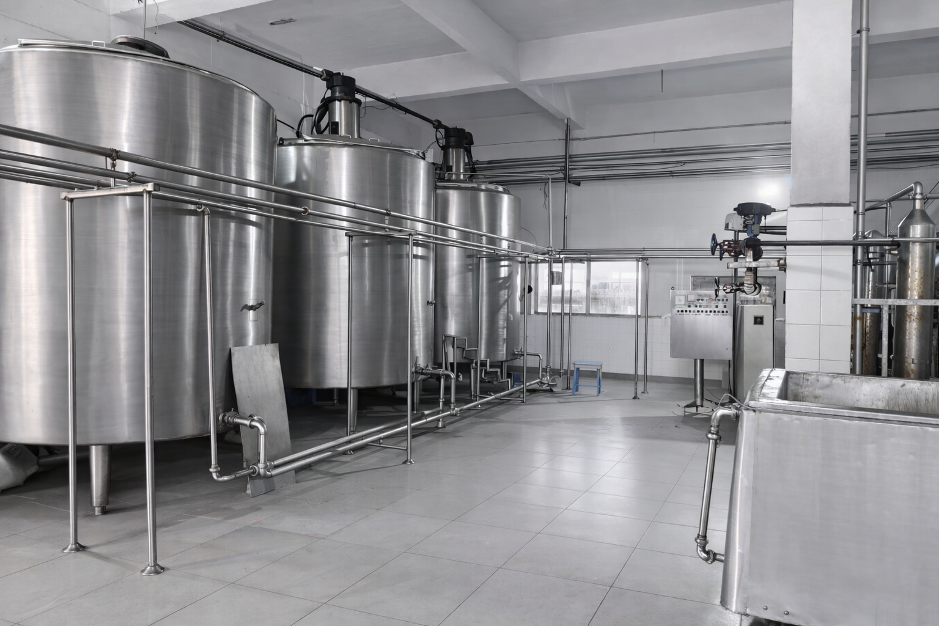
Ghee Storage Tanks

Slide 10
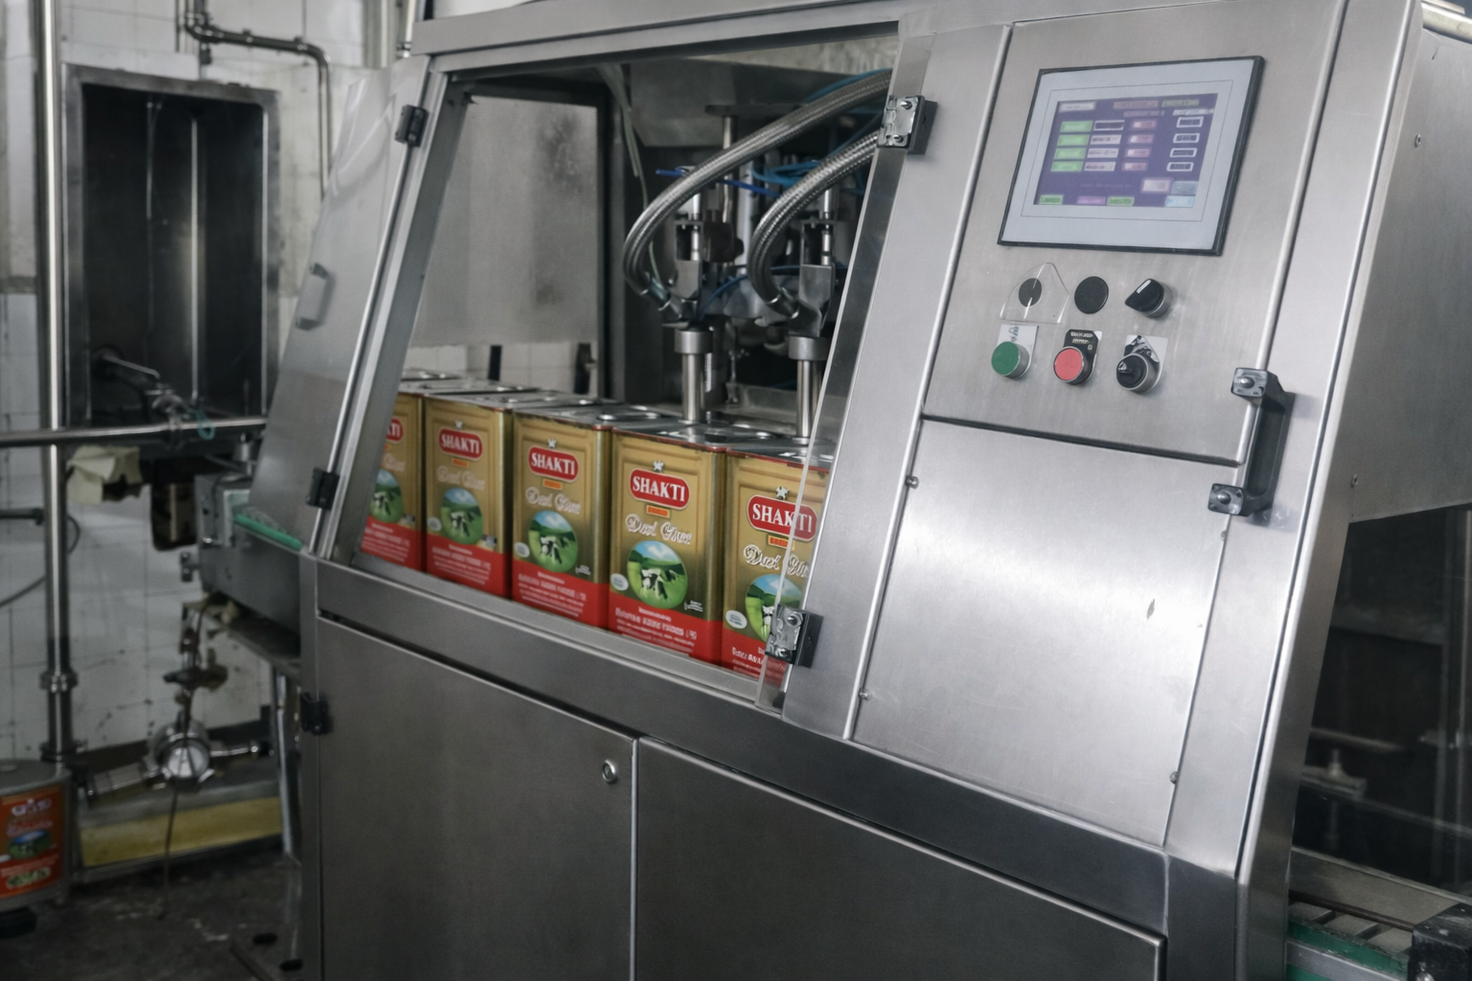
15 kg Tin Filling machine

Slide 11
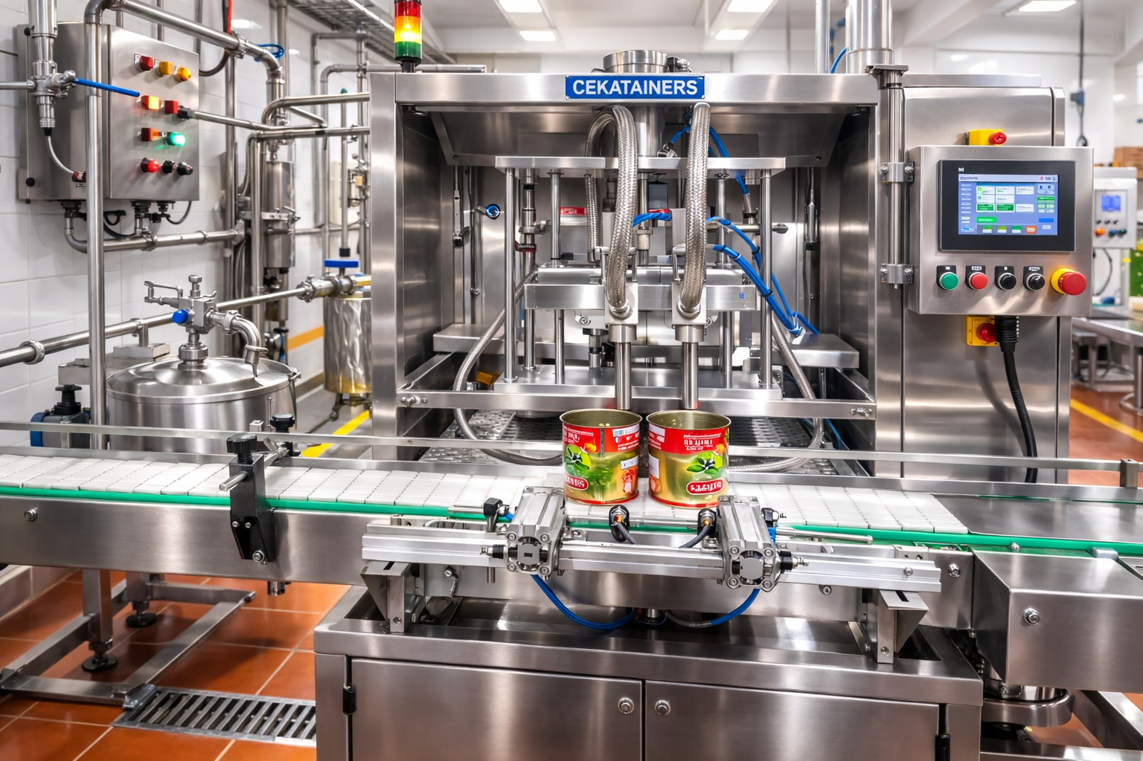
Consumer Pack Filling Machine

Slide 12
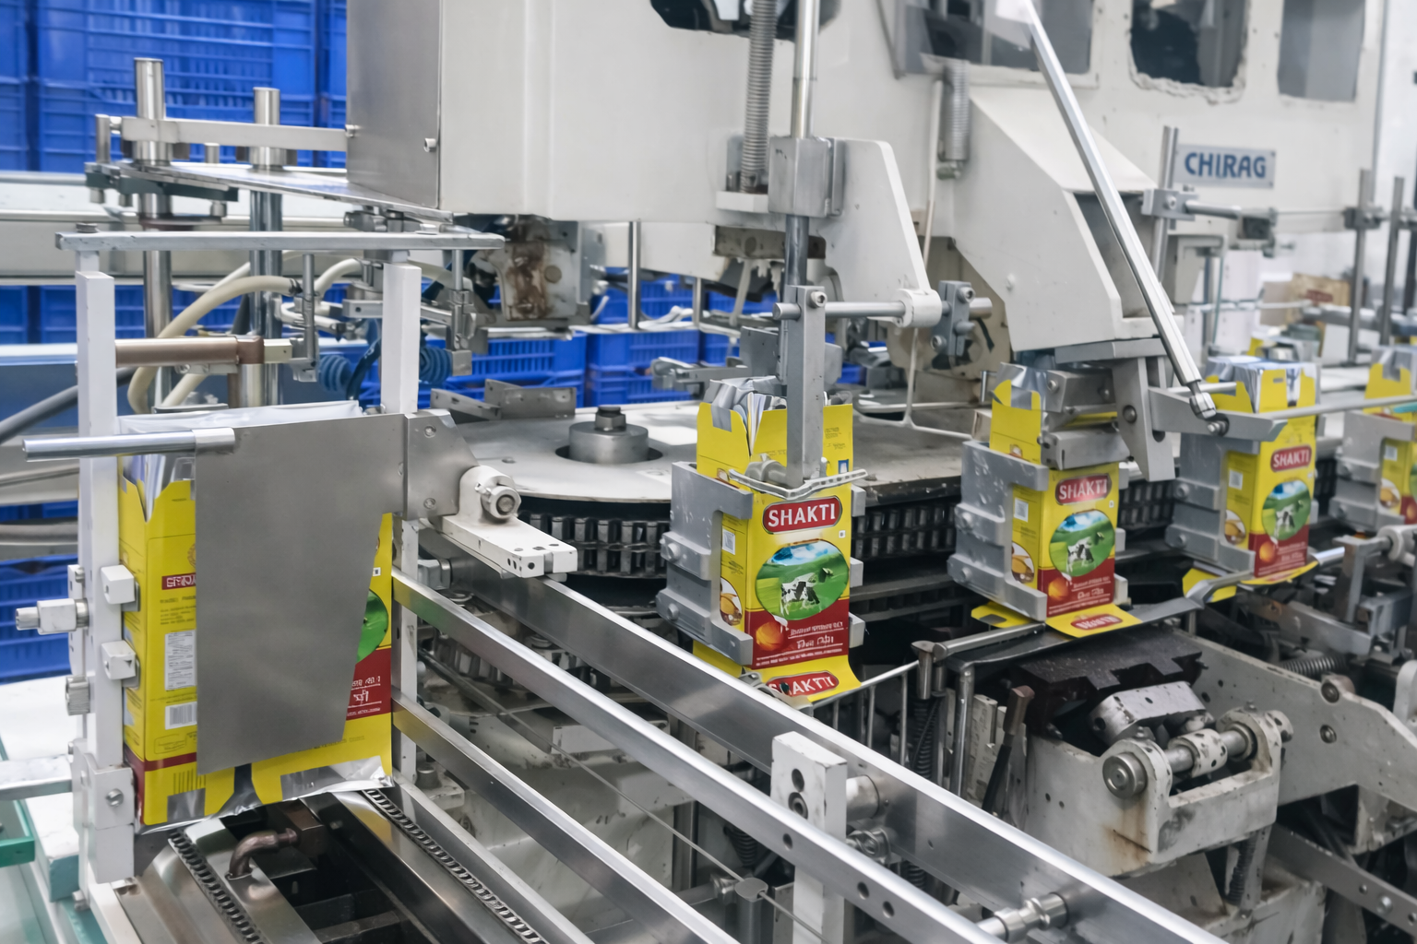
Ceka Pack Filling Machine

Slide 13
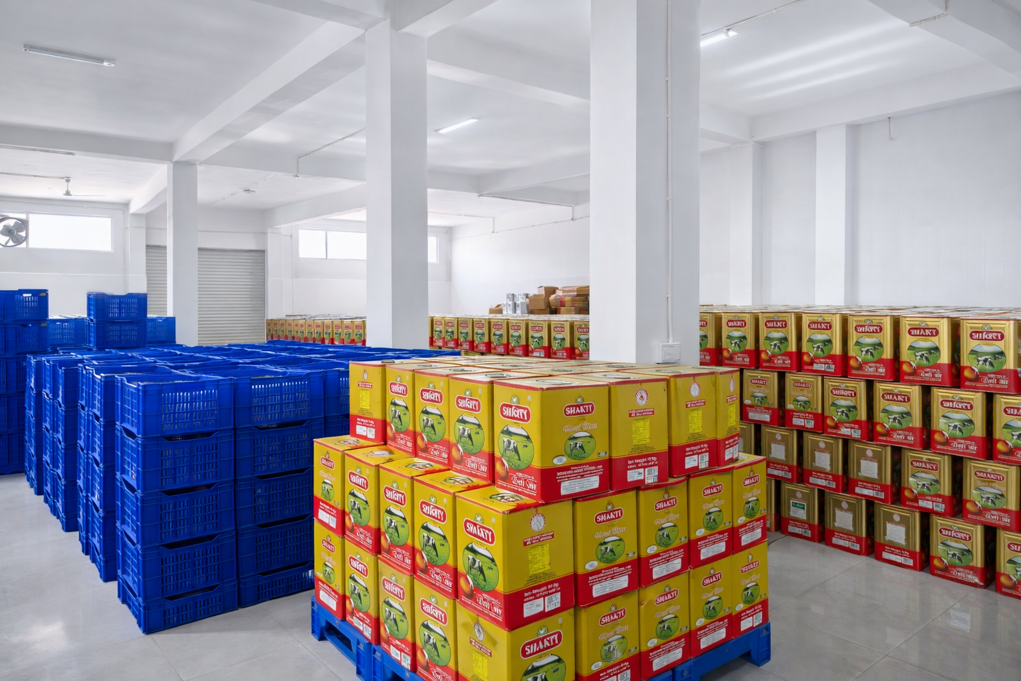
Packed Ghee Godown Area

Slide 14
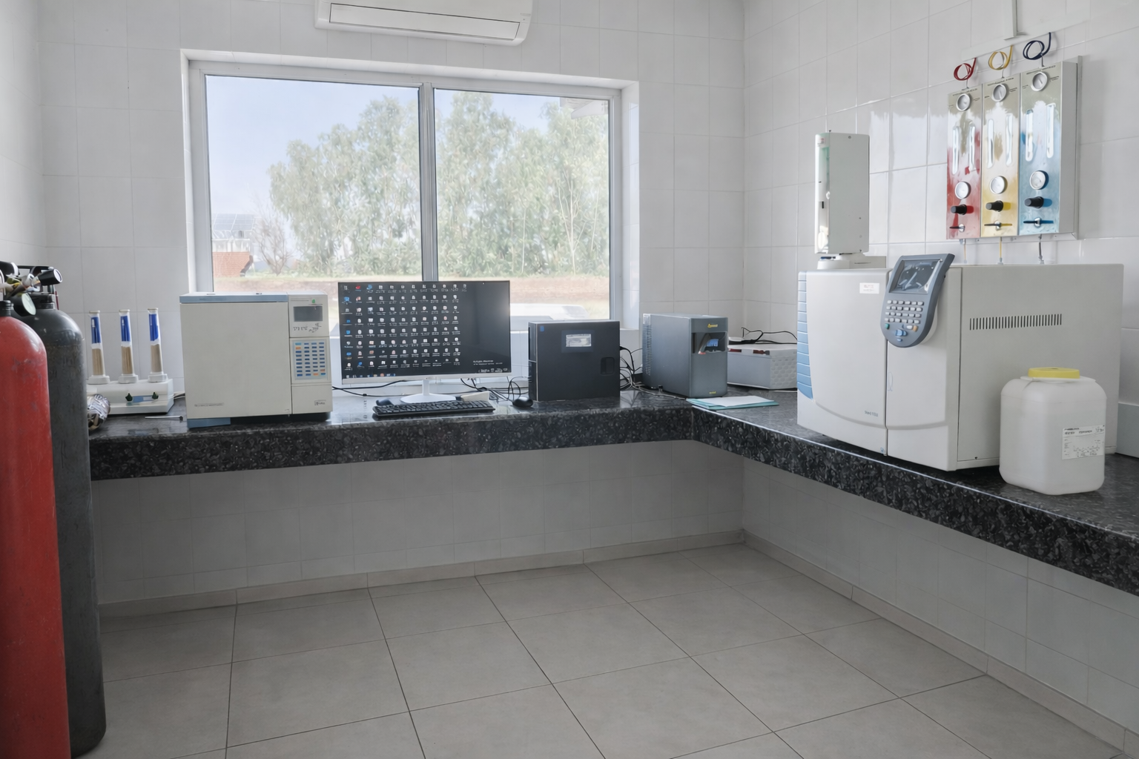
GC Machine Room

Slide 15
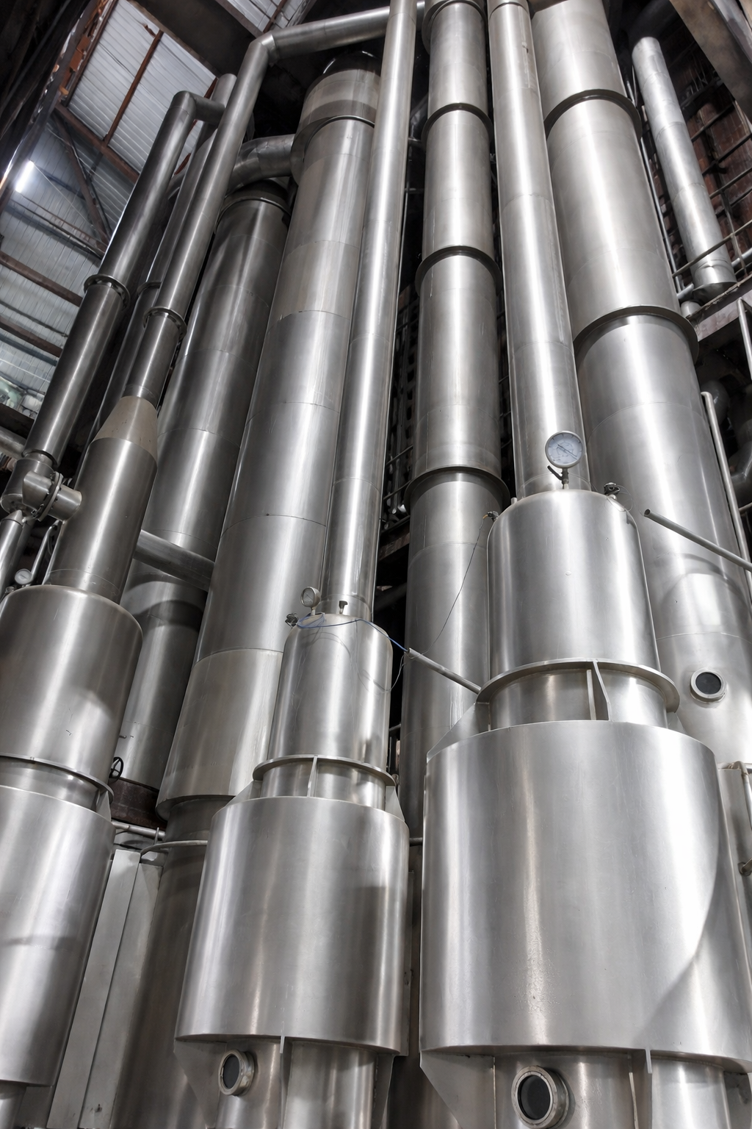
Milk Evaporator

Slide 16
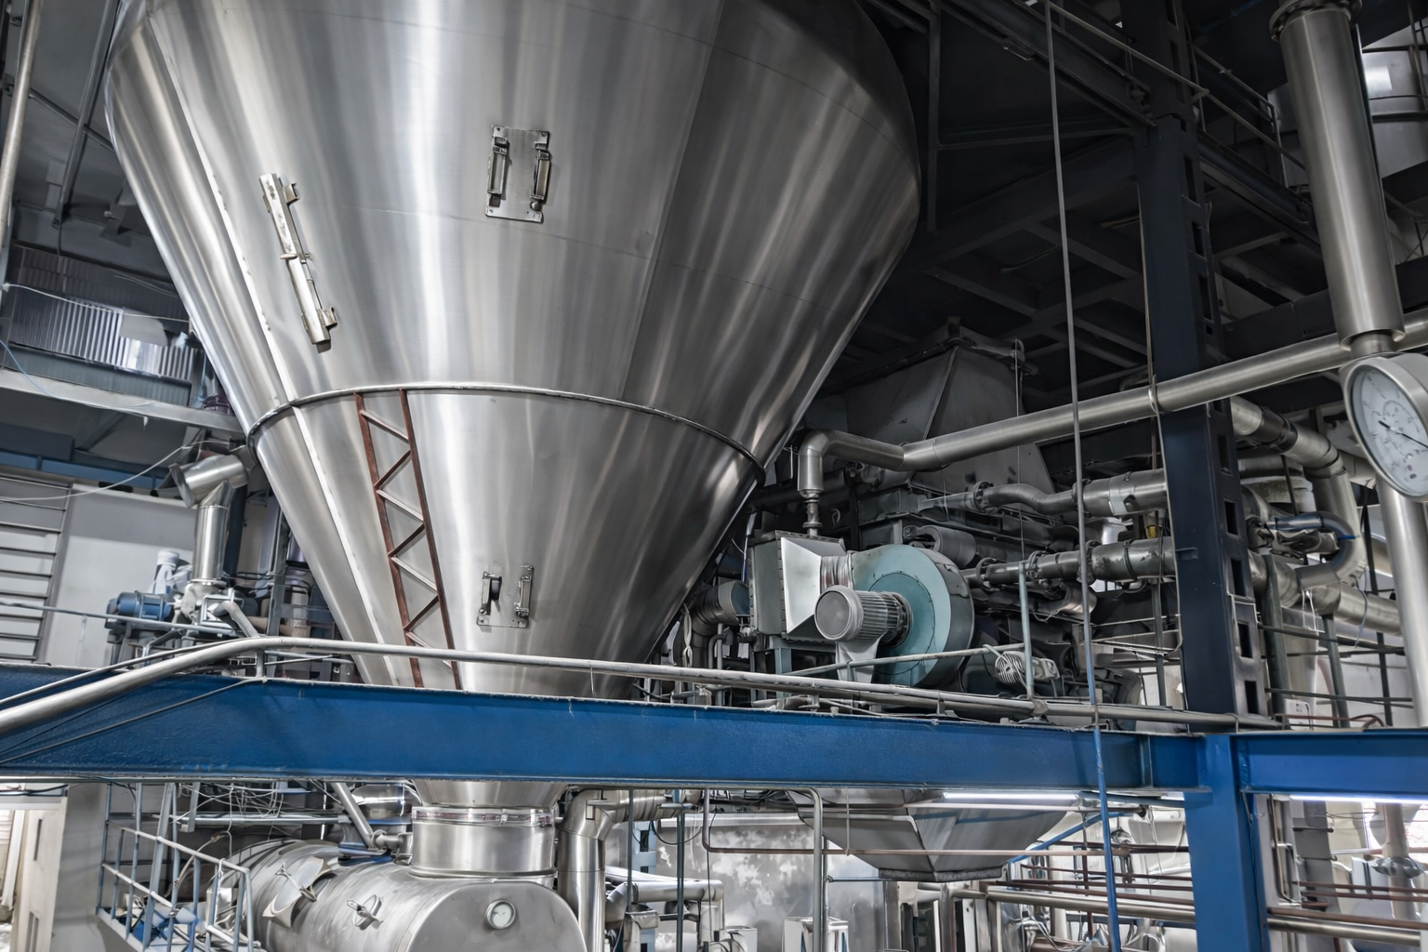
Milk Dryer

Slide 17
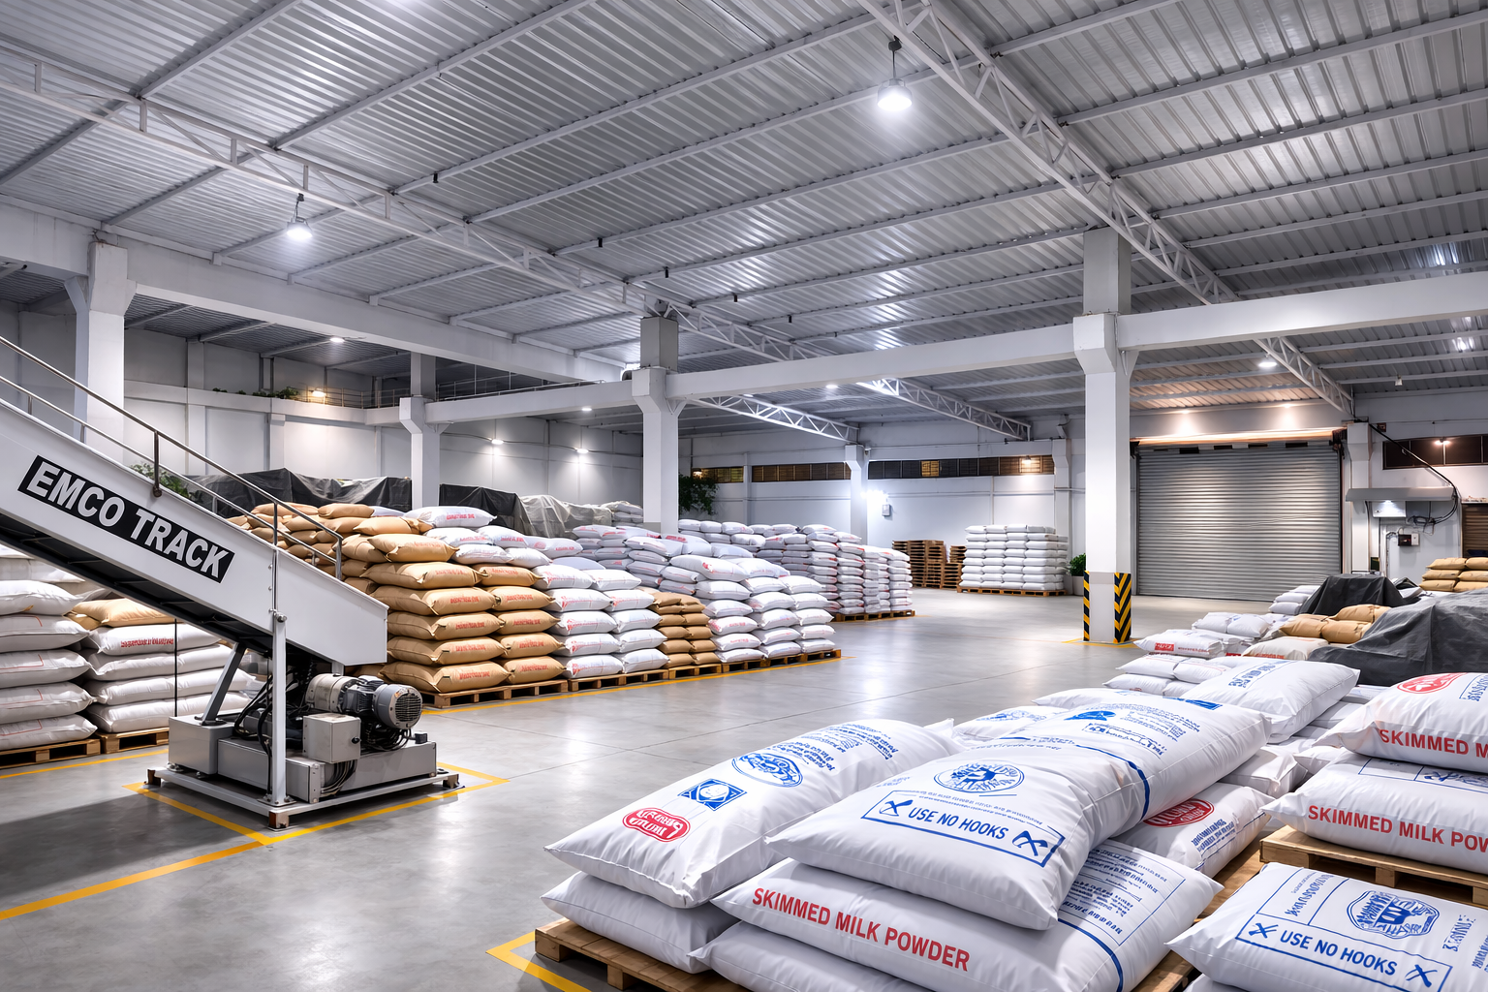
SMP Storage Godown

